Slide 1
Agentic AI Hackathon: Building Intelligent Agents with IBM Granite and LangFlow

Slide 2



Name of the team: GTV
Details of Team members
TEAM MEMBER NAME | Recent Passport Photo | Email ID | Phone number [WhatsApp]
TEJASHWINI.M |  | tejutejashwini606@gmail.com | 9620338676
VAISHNAVI.G |  | vaishnaviyadav470@gmail.com | 8722305428
PALLAVI.GS |  | gspallavi56@gmail.com | 7795859262

Slide 3

Problem statement
AI-Based Traffic Congestion Monitoring and Alert System
The Challenge
Urban traffic congestion is influenced by dynamic factors such as vehicle density, peak-hour demand, road incidents, and weather conditions. Traffic management systems collect large volumes of real-time and historical traffic data, but continuous manual analysis is infeasible. This results in delayed identification of congestion buildup and reactive traffic management. There is a need for an intelligent assistive system that can continuously analyze traffic data and identify congestion risks at an early stage.
Traffic Data Analysis Agent
An agent that ingests real-time and historical traffic data including vehicle speed, traffic volume, road occupancy, and incident reports, and organizes them into interpretable traffic trends.
Congestion Trend Detection Agent
An agent that analyzes short-term and long-term traffic patterns to detect abnormal slowdowns, bottlenecks, and congestion formation using historical baselines and threshold-based rules.
Alert & Traffic Advisory Assistant
An agent that generates early congestion alerts and provides route-level traffic advisories (assistive only, non-enforcement).
Outcome
Enable early detection of congestion patterns, improve situational awareness, and supports proactive traffic management.
Mandatory Tech Stack
Lang Flow using IBM Granite Model
(Using RAG on traffic management guidelines, congestion thresholds, and trusted transportation references.)

Slide 4
Proposed solution
The proposed solution is an AI-driven, multi-agent traffic intelligence system built using IBM LangFlow and IBM Granite models to monitor, analyze, and manage urban traffic congestion in real time.
The system collects traffic data such as vehicle speed, traffic volume, road occupancy, incidents, and weather conditions. This data is processed through multiple intelligent agents, each responsible for a specific task, ensuring modularity, scalability, and accuracy.
First, the Traffic Data Analysis Agent cleans, structures, and summarizes real-time and historical traffic data to identify current traffic conditions. Next, the Congestion Detection and Prediction Agent compares current traffic metrics with historical baselines to detect congestion and predict potential congestion in the near future.
An Incident and Emergency Detection Agent identifies accidents, road blockages, or adverse weather conditions that may impact traffic flow. Based on these insights, the Alert and Advisory Agent generates early traffic warnings and provides route-level advisory suggestions for commuters while prioritizing emergency vehicles when required.
Finally, the City Traffic Insights Agent provides actionable insights for traffic authorities, highlighting recurring congestion zones, peak traffic periods, and recommendations for long-term traffic optimization.
This system enables proactive traffic management, faster emergency response, and reduced travel delays, making it a scalable and intelligent solution for smart city transportation systems.

Slide 5
Need of project
The proposed solution is an AI-based traffic congestion monitoring and alert system implemented using a multi-agent architecture in IBM LangFlow with IBM Granite models. Each agent performs a specific role, and together they provide an end-to-end intelligent traffic management solution.
Agent 1: Traffic Data Analysis AgentThis agent is responsible for collecting and analyzing real-time and historical traffic data such as vehicle speed, traffic volume, road occupancy, time, and location.It cleans and structures the data to generate a clear summary of current traffic conditions, which acts as the foundation for further analysis.
Agent 2: Congestion Detection & Prediction AgentThis agent compares the current traffic conditions with historical traffic patterns to detect congestion.It also predicts the risk of congestion in the next 15–30 minutes, enabling early identification of traffic build-up and bottlenecks.
Agent 3: Incident & Emergency Detection AgentThis agent identifies traffic incidents such as accidents, road blockages, and adverse weather conditions.It evaluates how these incidents impact traffic flow and flags emergency-priority situations that require immediate attention.
Agent 4: Alert & Traffic Advisory AgentBased on congestion and incident insights, this agent generates early traffic alerts for commuters.It provides route-level advisories and alternative path suggestions, and gives priority routing recommendations for emergency vehicles when required.
Agent 5: City Traffic Insights & Decision Support AgentThis agent analyzes long-term traffic and incident trends to generate actionable insights for traffic authorities.It highlights peak congestion zones, recurring bottlenecks, and suggests traffic optimization and planning measures for smarter city management.

Slide 6
End user of project
  Daily Road Users (Commuters)
  People who travel daily for work, education, or personal purposes can use the system to receive early traffic alerts and route advisories to avoid congestion.
  Drivers and Vehicle Owners
  Car, bike, and taxi drivers benefit from real-time traffic updates and alternative route suggestions, helping them save time and fuel.
  Public Transport Operators
  Bus and transport service providers can use traffic insights to optimize routes and schedules during peak congestion hours.
  Emergency Services
  Ambulance, fire, and police services can use priority routing recommendations to reach destinations faster during emergencies.
  Traffic Control Authorities
  City traffic police and municipal authorities can use congestion reports and analytics for traffic monitoring, planning, and management.
  Smart City Administrators
  Urban planners and smart city officials can use long-term traffic insights for infrastructure improvement and policy decision-making.

Slide 7
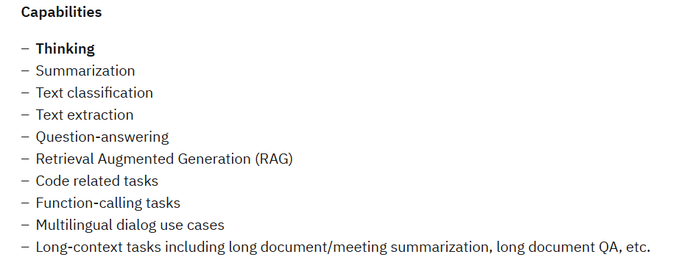
Technology Used
Langflow platform
Langflow component name – Agent , Chat input , Chat output
IBM Grainte model - for eg – ibm-granite-3-2-8b
IBM Cloud
IBM Watson studio
Watson machine learning
Watsonx governance
Could object storage
IBM Watsonx.ai
Watsonx

Slide 8
Novelty and Uniqueness
The novelty of this project lies in its agent-based AI architecture implemented using IBM LangFlow, where multiple intelligent agents collaboratively handle traffic monitoring, congestion detection, incident identification, alert generation, and decision support. Instead of using a single monolithic model, the system divides responsibilities among specialized agents, making the solution more modular, scalable, and efficient.
Unlike conventional traffic monitoring systems that react only after congestion occurs, this project introduces early congestion prediction by comparing real-time traffic conditions with historical patterns. This enables proactive traffic management and timely alerts.
A key unique feature is the incident and emergency-aware intelligence, where the system identifies accidents, abnormal traffic behavior, and adverse conditions, and adjusts traffic advisories accordingly, including priority routing considerations.
The project also stands out by generating human-readable traffic alerts and advisories using IBM Granite LLMs, making complex traffic insights easily understandable to road users and authorities.
Additionally, the system provides decision-support insights for traffic authorities, highlighting recurring congestion zones and suggesting long-term improvements, which extends its usefulness beyond daily commuters to smart city planners.

Slide 9
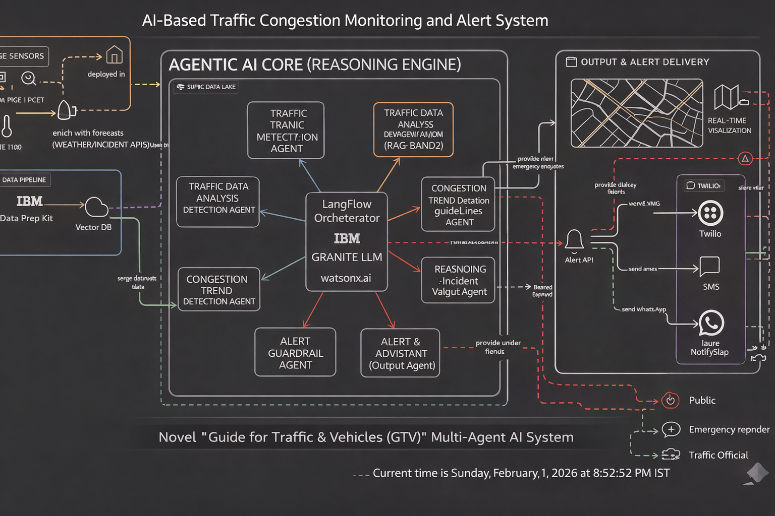
Technical flow diagram - Architecture blueprint

Slide 10
Langflow component Used
Explain the use of each langflow component used into you project
1) Chat Input
2) IBM watsonx AI Agent
File component
Chat output
5) Agents

Slide 11
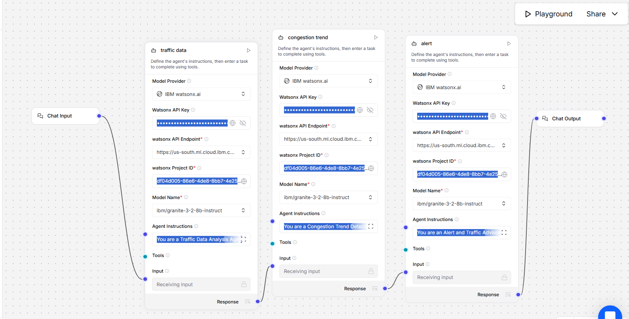
Input Screenshot 1

Slide 12
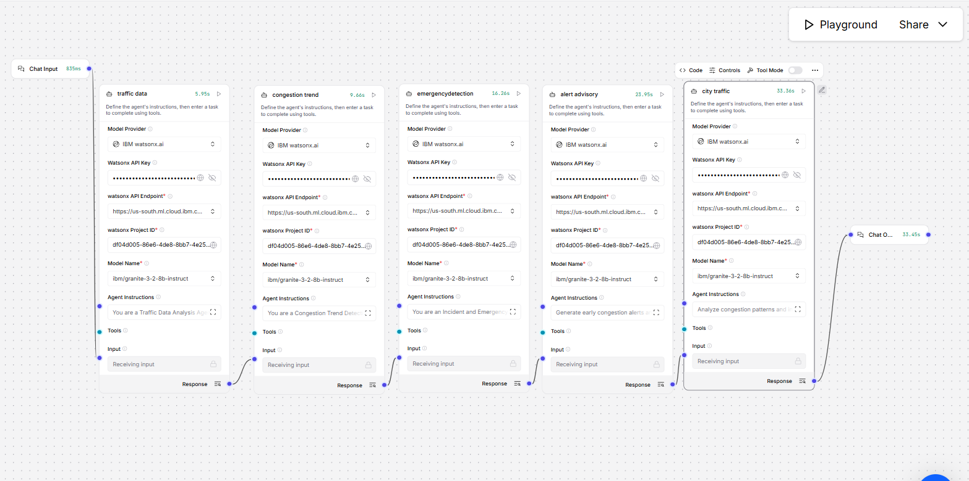
Input Screenshot 2

Slide 13
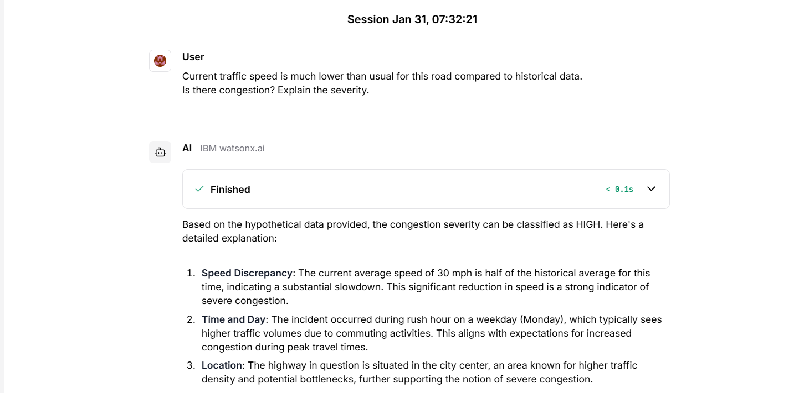
Output Screenshot 1

Slide 14
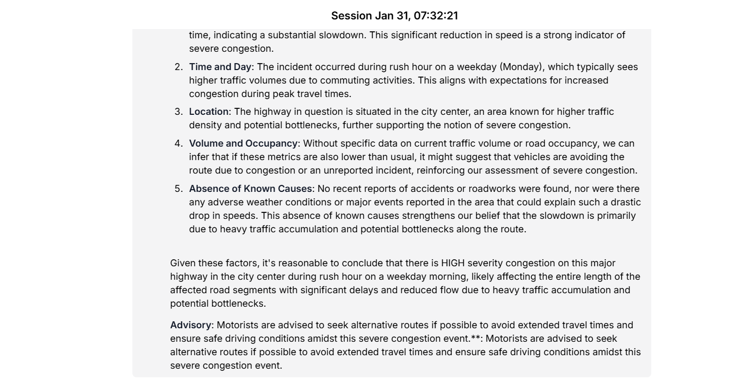
Output screenshot 2

Slide 15
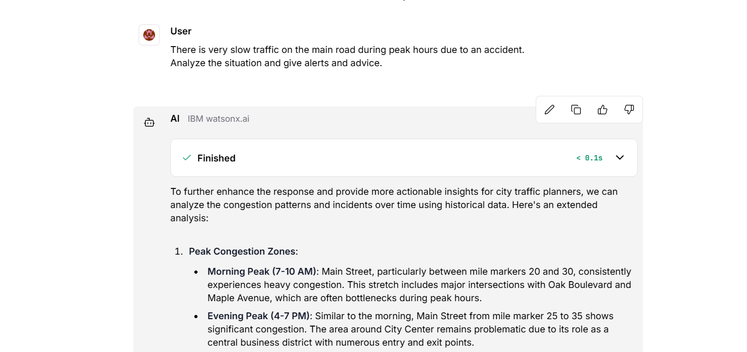
Output screenshot 3

Slide 16
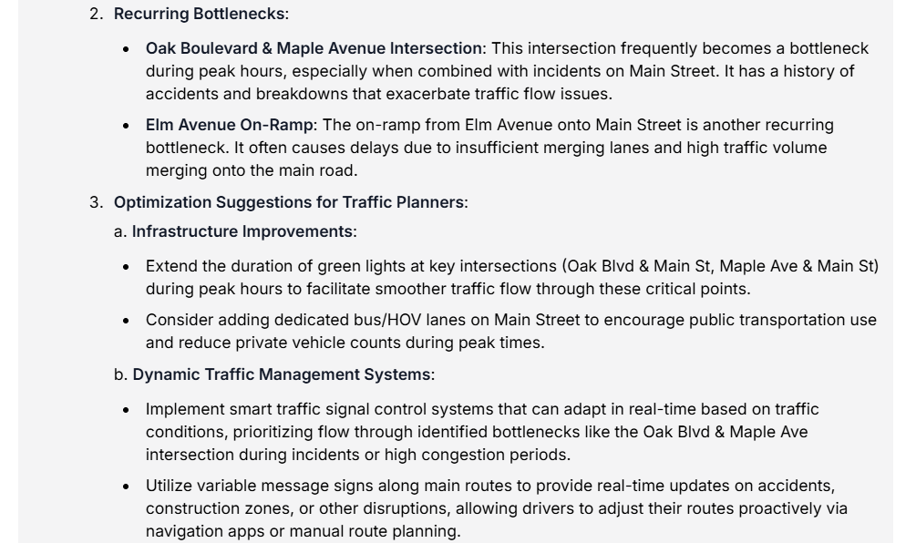
Output screenshot 4

Slide 17
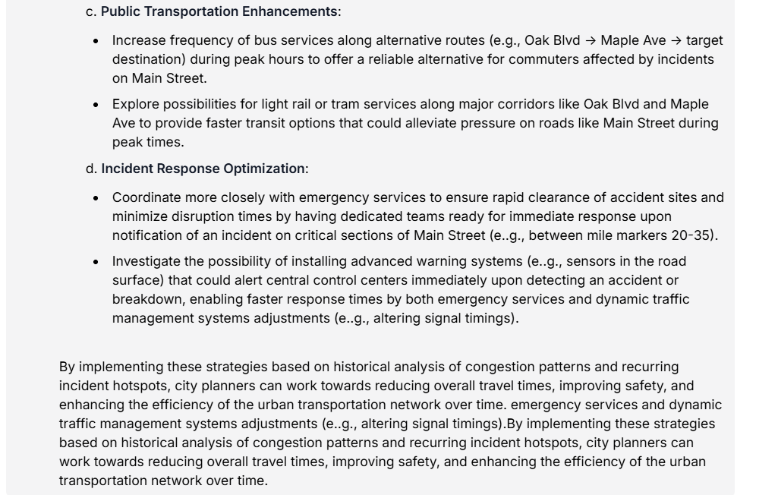
Output screenshot 5

Slide 18
Future Scope
The system can be enhanced by integrating real-time traffic sensors, CCTV feeds, and GPS data to improve accuracy and responsiveness.
Advanced AI and machine learning models can be used to improve short-term and long-term traffic congestion prediction.
A mobile or web application can be developed to deliver real-time alerts and route advisories directly to users.
The solution can be integrated with smart traffic signal systems to dynamically control signals based on congestion levels.
The system can be scaled to support multiple cities, enabling centralized traffic monitoring and smart city traffic management.
·
·
·

Slide 19
Git Hub Link
· Please create public github repository (Enable Add README button while creating repository) with format –
Please test and Paste the working Github URL –https://github.com/tejutejashwini606-star/AI-traffic-congestion-monitoring-system-ibm.git
·
·
·

Slide 20
References
IBM LangFlow & Vector Databases
IBM LangFlow GitHub (Official):
https://github.com/langflow/langflow
(LangFlow opensource visual LLM workflow builder)
Vector Databases for retrieval (general):
https://www.oreilly.com/library/view/vector-databases/9781098151855/
(Chapter-level overview)
5. LLMs with External Knowledge (RAG)
https://arxiv.org/abs/2005.11401
(RAG — Retrieval-Augmented Generation)
https://www.ibm.com/cloud/learn/retrieval-augmented-generation
(IBM explainer for RAG + LLM integration)
·
·
·

Slide 21


